Slide 1
Detection of Parabolic Weld Defects from TOFD Scans
Roopsa Sen
2nd year, QEDM, Industrial Engineering
IIT Kharagpur
12 January 2022 - 19 January 2022

Slide 2
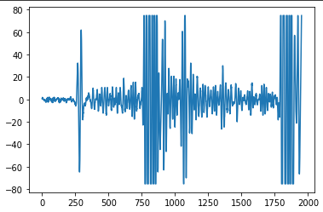
Sample A-scan

Slide 3
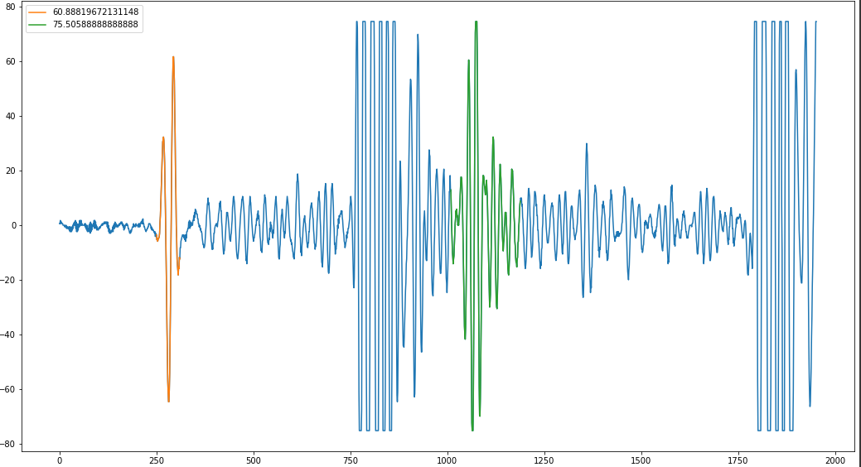
Detecting peaks from A-scan
Thresholding values in A-scan in comparison to neighbouring regions
Selecting only regions with high Signal to noise ratio to reduce noisy regions

Slide 4
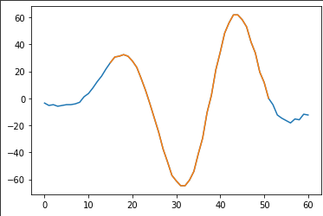
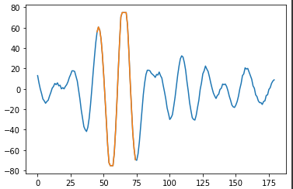
Selecting only peak region from Region of Interest

Slide 5
Final result for Sample A-scan

Slide 6
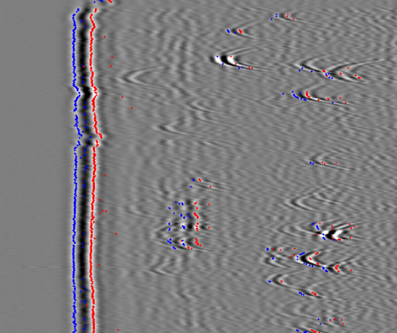
Current result with only A-scan

Slide 7
Next steps
Better method of noise detection
Cluster points and get point with highest peak value for each parabola

